Slide 1
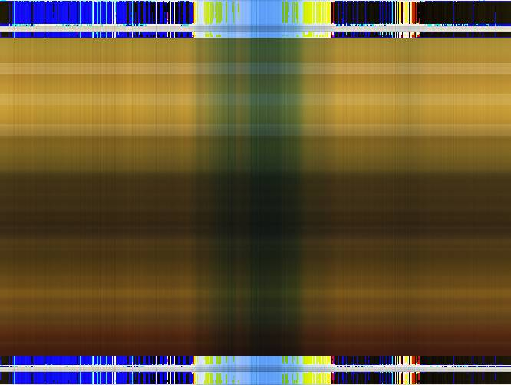

Slide 2
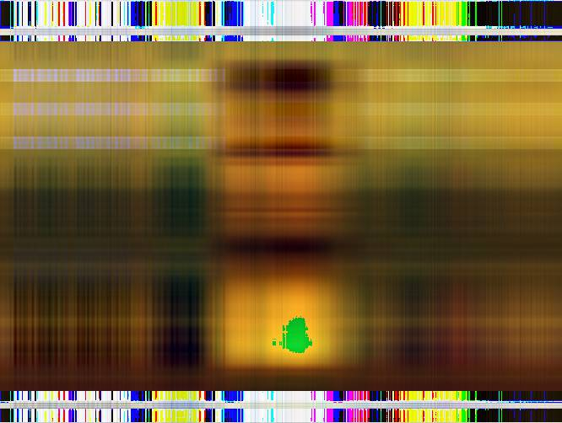

Slide 3
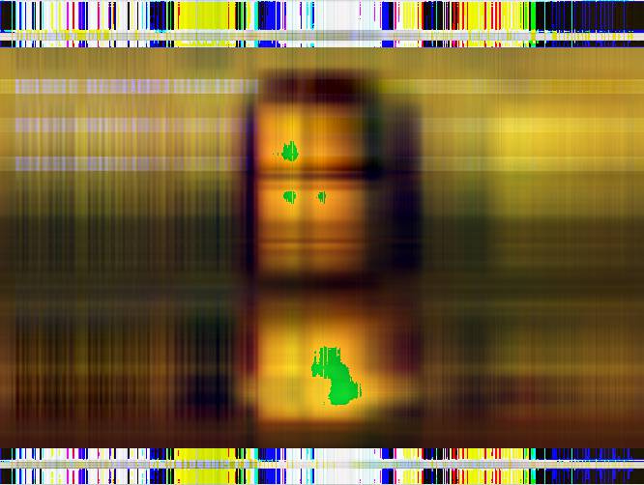

Slide 4

Master in Advanced Analytics, NOVA IMS - Descriptive Analytics
image reconstruction with principal components
Lisbon, December 2015 András Kolbert, Beáta Babiaková, Carolina Duarte

Slide 5
contents
PCA and Images - The Basics
Interpreting the Results of PCA
Missing Values - A Visual Approach
Real World Applications

Slide 6

pca and images - the basics
Columns -> Variables
Each pixel contains an array with 3 values: R G B
Rows -> Observations

Slide 7
interpreting the results of pca
To interpret the results interactively, we developed an app using a package of R: Shiny
It is now available at: https://principalimages.shinyapps.io/Shiny
R You Ready?
Notes:
Cov vs Cor: doesn’t make much difference in this case because the variables don’t have any specific meaning - they are equivalent - and also vary in the same range.
Loadings: in this case it also doesn’t make sense because the same7
Scree plot: mention we used log scale

Slide 8
reconstruction of damaged pictures
Imputing Missing Values before applying PCA
Impute missing values first
R package Multivariate Imputations by Chained Equations (MICE)
Method Predictive Mean Matching (pmm)
Perform PCA on the new, completed dataset

Slide 9

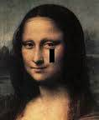
reconstruction of damaged pictures
Imputing Missing Values before applying PCA
Original vs damaged
Original Picture
Damaged Picture

Slide 10

reconstruction of damaged pictures
Imputing Missing Values before applying PCA
Damaged vs treated
Damaged Picture
Treated Picture

Slide 11
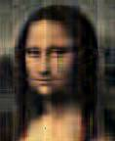
reconstruction of damaged pictures
Imputing Missing Values before applying PCA
damaged vs. treated 10 PCs
Damaged Picture
Treated Picture using 10 PCs

Slide 12
reconstruction of damaged pictures
Using PCA to impute Missing Values
Remove the rows with missing values;
Perform PCA on the new, smaller dataset;
Use the principal components of this dataset to estimate the missing values.

Slide 13

reconstruction of damaged pictures
Using PCA to impute Missing Values
Damaged Picture
Treated Picture using 10 PCs

Slide 14


reconstruction of damaged pictures
Using PCA to impute Missing Values
Damaged Picture
Treated Picture using 10 PCs

Slide 15
real world applications
Face Recognition
PCA identifies a small set of characteristic features, known as eigenfaces, which are the PCs of the training set. New individuals can then be classified.
Image Compression
PCA allows reduction of the image storage space. The compression rate is given by: 1- Nbr. of Principal Components Used/ Total Number of Variables.

Slide 16
references
Image Reconstruction with PCA:
Hladnik, A. (January 01, 2012). Image compression and face recognition: two image processing applications of principal component analysis. Abstracts.
Jolliffe, I. T. (2002). Principal component analysis. New York: Springer.
Renkjumnong, W. (2007). SVD and PCA in image processing.
Santo, R. E. (January 01, 2012). Principal Component Analysis applied to digital image compression. Einstein (são Paulo, Brazil), 10, 2.)
Dealing with Missing Values:
CRAN. (November 9, 2015). Mice Package. Retrieved from: https://cran.r-project.org/web/packages/mice/mice.pdf
Ilin, Alexander, & Raiko, Tapani. (2008). Practical Approaches to Principal Component Analysis in the Presence of Missing Values. (Helsinki University of Technology.) Helsinki University of Technology.
RBloggers. (October 4, 2015). Imputing Missing Data with R; Mice Package. Retrieved from: http://www.r-bloggers.com/imputing-missing-data-with-r-mice-package/
StatisticalHorizons. (March 5, 2015). Imputation by Predictive Mean Matching: Promise & Peril. Retrieved from:http://statisticalhorizons.com/predictive-mean-matching
Shiny Apps:
RStudio. (2014). Shiny Dashboard. Retrieved from: https://rstudio.github.io/shinydashboard
RStudio. (2014). Shiny - Tutorial. Retrieved from: http://shiny.rstudio.com/tutorial/

Slide 17

Thank you for your attention

